Slide 1
RUNGTA COLLEGE OF DENTAL SCIENCES & RESEARCH
TITLE OF THE TOPIC- ENDODONTIC SURGERY
DEPARTMENT OF – CONSERVATIVE DENTISTRY AND ENDODONTICS

Slide 2
Specific learning Objectives
At the end of this presentation the learner is expected to know ;
Core areas* | Domain ** | Category #
Introduction | Cognitive | Must know
Method | Psychomotor | Must know
Armamentarium | Cognitive | Must know
*Subtopic of importance
** Cognitive, Psychomotor or Affective
# Must know , Nice to know & Desire to know
( Table to be prepared as per the above format )

Slide 3
TABLE OF CONTENTs
Definition
Indication
Contraindication
Classification
Anatomic consideration
Patient preparation
Surgical access
Haemostasis
Root end resection and preparation
Root end filling
Flap closure and suture
Postoperative complications

Slide 4
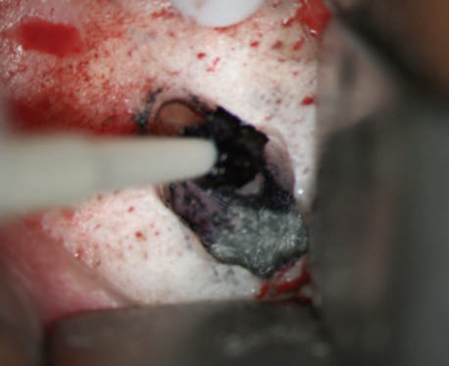
Methylene Blue Staining (MBS)
MBS only discolors organic substances
Delineates the PDL with a deep blue color but also
stains isthmuses, accessory canals, hairline
MBS is applied with a micro applicator tip saturating the surface and the PDL and leaving it undisturbed for 10–15 s
All staining is then rinsed with isotonic saline and
dried thoroughly with a Stropko irrigator/drier.

Slide 5
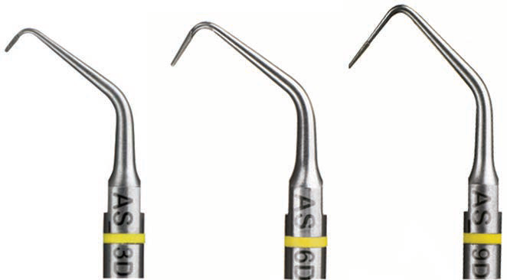
Ultrasonic tips of varying lengths: 3 mm, 6 mm, and 9 mm
Modern ultrasonic tips can facilitate the preparation of a 3, 6, or even 9 mm root end cavity depending on the length of the unprepared canal space or the presence of intraradicular restorations

Slide 6
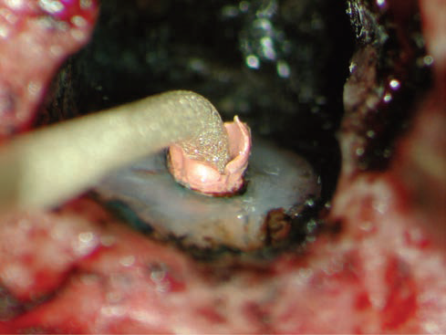
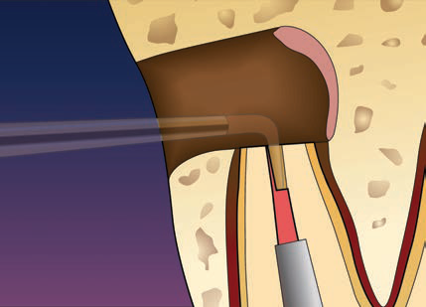
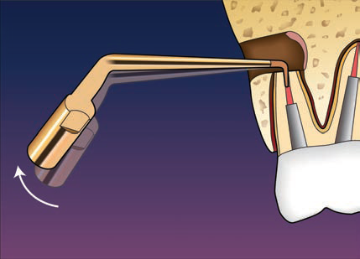
When root end preparation is done in the correct
direction, gutta percha is “walking”out of the preparation
In order to remove excess GP, the ultrasonic tip can be angled buccally so that the end of the tip will vibrate against the facial wall and gradually loosen the remaining filling material

Slide 7
The CVD tips - chemical vapor deposition
This new technology deposits a thick layer of pure
diamond, forming a single stone that covers the entire surface of the tip
The technique of manufacturing these tips may explain their maintenance of shape even after utilization
CVD tips exhibited the shorter preparation time and did not present fractures

Slide 8
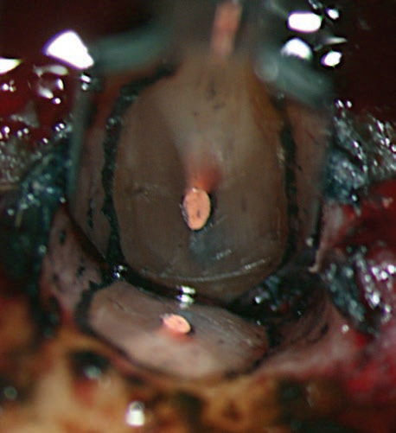
After methylene blue staining, the PDL appears as an uninterrupted circular line around the root surface

Slide 9
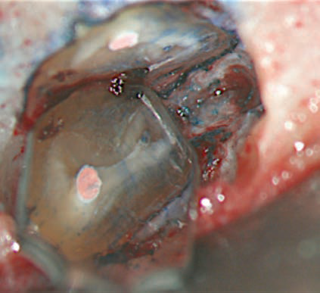
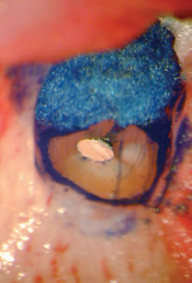
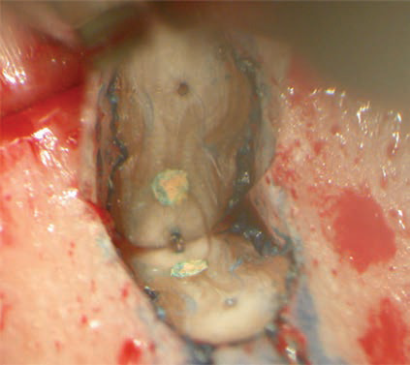
(a) Missed lingual canal and unprepared isthmus; (b) vertical root fracture; (c) multiple accessory canals;

Slide 10
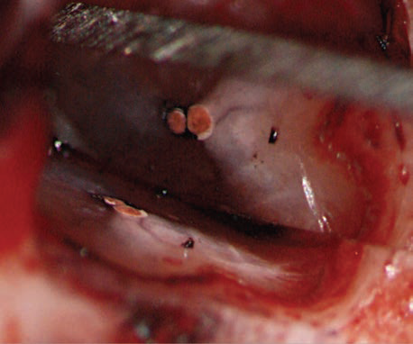
Macrofindings and Microfindings
Macrofindings
Isthmuses and missed canals
Microfindings
Craze lines, which are defined as dark lines that appear to disrupt the integrity of the dentine,
cracks,
the areas of “frosted” dentine and gaps
“Frosted” dentine was defined as a whitish or opaque dentine as opposed to the normal greyish or yellowish dentine, and cannot be stained with MBS
Fracture lines are stained by MBS whereas craze lines are not.

Slide 11
‘‘Bow-Tie’’ effect
‘‘Radial dentin’’
Faint lines are not fractures, but represent the transitional line angles of the root dentin/tubules Because the dentinal tubules refract light differently, depending on their orientation to the light source, they will present a different appearance when viewed with incident light
It tracks back to the obliterated pulp space, serving as a map to the narrowed canal.
This ‘‘radial dentin’’ tracks back to the obliterated pulp space, serving as a map to the narrowed canal. The radial dentin, apically, will point to the central location of the canal space and isthmus.
This indication is especially important if the dye used did not disclose any canal/isthmus but the radial dentin suggests that it is present; the conclusion must then be drawn that the resection level did not cut through, and thereby expose, the canal/isthmus enough to capture the dye.
The clinical decision is then made to either root end prepare according to the radial dentin outlines, or resect slightly more of the root end to reveal the suspected space(s)
Niemczyk et al; Essentials of Endodontic Microsurgery; Dent Clin N Am 54 (2010) 375–399

Slide 12
Water prism fluid / Water bending effect
Mandibular anterior apices
After resection, the crypt is rinsed with sterile saline until it runs clear and the saline is allowed to remain in the crypt.
With the proper fluid level, it is possible to view the resected surface without the micromirror by the prism effect of the fluid without altering the position of the DOM. but the fluid itself offers a weak hemostatic tamponade effect
Notes:
, where space in the crypt is often cramped and bleeding slightly. The level of the fluid can be adjusted through judicious suctioning with a microcannula, until the whole root end surface can be observed.
.
, the fluid level is adjusted to reveal how much of the light and view was being ‘‘bent’’

Slide 13
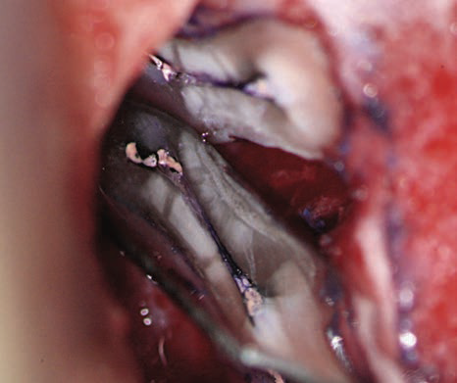
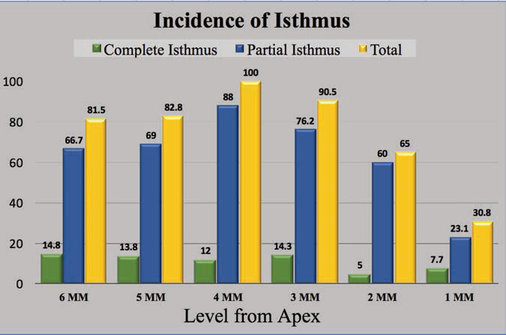
Isthmus
A narrow, ribbonshaped communication between two root canals that contains pulp, or pulpally derived tissue.
This connection is called an isthmus, and it is either complete or partial
At the 3-mm level from the original apex, an isthmus was found at 90% of the mesiobuccal roots of maxillary first molars, 30% of the maxillary mandibular premolars, and over 80% of the mesial roots of the mandibular first molars
Notes:
A tooth with a fused oval-shaped root has a web-like connection between two canals.

Slide 14
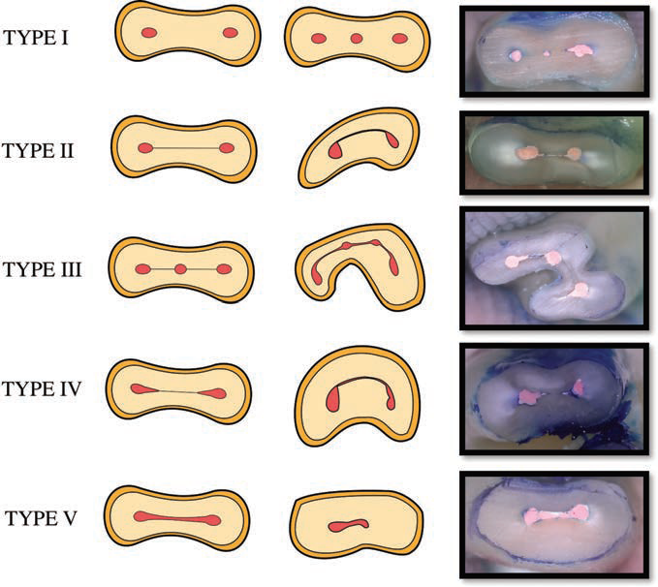
Types of Isthmus
Isthmus was classified by Weller et al. (1995) as complete or partial.
A complete isthmus was one with a continuous, narrow opening between the two main root canals.
A partial isthmus was defined as an incomplete communication with one or more patent openings, through the section, between the two main canals.
Types of isthmuses:
type I, two or three canals with no noticeable communication;
type II, two canals that had a definite connection between the two Main canals;
type III differs from type II in that there are three canals instead of two;
type IV are canals that extend into the isthmus area;
type V, a true connection or corridor throughout the section.
Hsu and Kim (1997)
Notes:
Type I was defined as either two or three canals with no noticeable communication.
Type II was defined as two canals that had a definite connection between the two main canals.
Type III differs from type II in that there are three canals instead of two.
Incomplete C-shapes with three canals were also included in a type IV isthmus.
Type V is identified as a true connection or corridor throughout the section

Slide 15
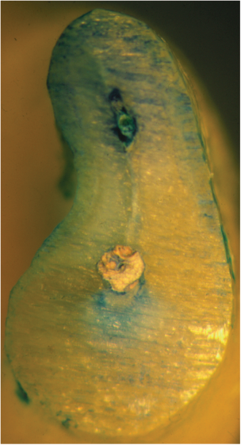
Clinical Significance and Management
If these anatomic features remain undetected, recurrence of infection and failure of apical surgery are unavoidable.
The isthmus should be identified and treated under the microscope with ultrasonics and microinstruments.
It is essential that the entire canal and isthmus be prepared to a depth of 3 mm

Slide 16
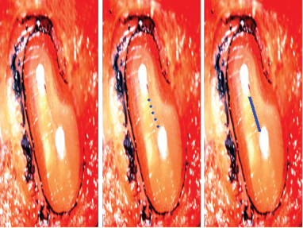
Dot Technique
To establish a tracking groove
Tip is inactivated and no water spray, the pointed tip is placed exactly where desired and just lightly ‘tap’ the rheostat for an instant.
The process is repeated again, until there are a series of ‘dots’ created on the isthmus.
The dots are connected to create the initial ‘tracking groove’
The accuracy of cutting is then maintained and the probability of ‘slipping off ’ a small, or thin, bevelled surface is eliminated
Notes:
After the groove is deep enough to guide the tip, the
water spray is turned back on and the preparation is
deepened to 3mm while using a similar small, pointed
tip..
Then, a larger and more efficient coated tip is used
to finish the walls and flatten out the floor of the REP to
the desired finish

Slide 17
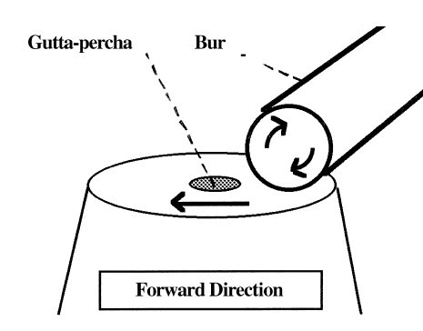
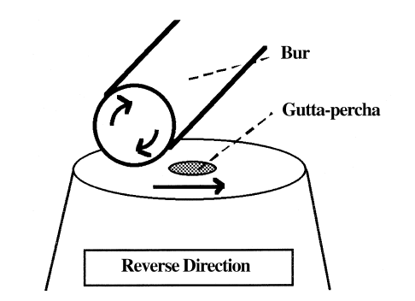
MANAGEMENT OF GUTTA‑PERCHA IN RETROPREPARED CAVITY
Multipurpose bur produced smoothest surface with least amount of shattering
Final pass of the bur across the root canal in the correct direction in relation to its direction of rotation prevent shredding of the gutta-percha
Ensures minimal disruption and distortion of the root filling
The present study shows that with respect to smearing of gutta-percha, the direction of cutting of the bur was far more important than the choice of instrument for root-end resection.
The results indicate that burs moved in the reverse direction produced a large degree of smearing and distortion of the gutta-percha. When the same burs were used in the forward direction, no gutta-percha was observed to have been smeared onto the root face
Weston, G.D., Moule, A.J., Bartold, P.M., 1999. A scanning electron microscopic evaluation of root surfaces and the gutta–percha interface following root-end resection in vitro. Int. Endod. J. 32, 450–458

Slide 18
Resected Root-End Surface Topography
To produce a smooth, flat root surface without sharp edges or spurs of root structure that might serve as irritants during the healing process,
Given that human PDL fibroblast attachment to a smooth surface was not impaired, it would seem appropriate to produce as smooth a surface as possible to facilitate inspection of the resected root end.
crosscut fissure burs in both high-speed and low-speed handpieces produced the roughest and most irregular surfaces.
The Multi-Purpose bur produced the smoothest, most uniplanar resected root-end surface, with the least amount of shattering.

Slide 19
Root-End Conditioning
Root surface conditioning removes the smear layer and provides a surface conducive to mechanical adhesion and cellular mechanisms for growth and attachment.
It exposes the collagenous matrix of dentin and retains biologically active substances, such as growth factors, in the dentin proper.
CITRIC ACID
Citric acid traditionally has been the solution of choice. Periodontists have used an aqueous solution of citric acid (pH 1) for 2 to 3 minutes to etch diseased root surfaces to facilitate formation, new attachment, and cementogenesis
However, the periodontal literature has questioned the benefit of etching dentin surfaces with low pH agents. At a low pH, adjacent vital periodontal tissues may be compromised.
EDTA
EDTA, 15-24% a solution with a neutral pH that endodontists have used as a canal irrigant, has been shown to be equally effective at exposing collagen fibers on dentin surfaces.
TETRACYCLINE
Tetracycline (pH 1.8)has been shown to remove the dentin smear layer, leaving clean, open tubules with application times as short as 30 seconds.
A histologic evaluation of new attachment in periodontally diseased human roots treated with tetracycline hydrochloride showed a trend for greater connective tissue attachment after tetracycline treatment of roots.
Unlike the lower-pH solution, EDTA does not adversely affect the surrounding tissues.
However the manufacturer has advised against the use of EDTA when mineral trioxide aggregate (MTA) is used as a root-end filling material, because it may interfere with the hard tissue–producing effect of MTA
Also, extended application (3 minutes) has been shown to discourage alveolar bone growth

Slide 20
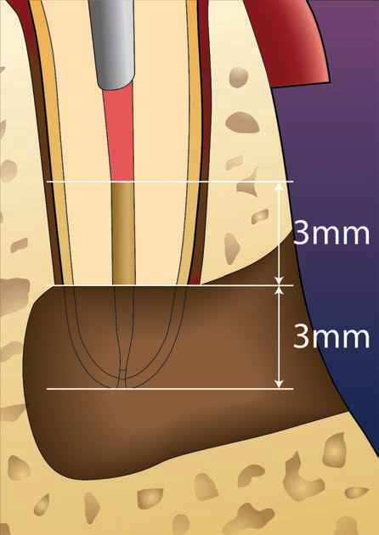
Root End Preparation
The aim of the root end preparation is to remove the filling material, irritants, necrotic tissue, and remnants from the canals as well as the isthmus and create a cavity that can be properly filled
The ideal root end preparation can be defined as a Class I cavity at least 3 mm into root dentine after the apical root tip of 3 mm is resected, with walls parallel to and within the anatomic outline of the root canal space.
Therapeutic length

Slide 21
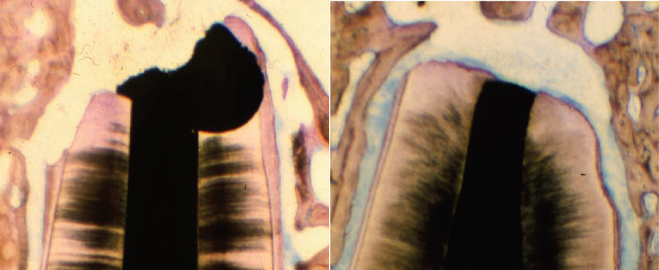
Use of ultrasonic root end tips instead of burs for the root end preparation
Less osseous tissue must be removed to gain proper access to the resected root end.
The surgeon is better able to produce a more conservative preparation that follows the long axis of the tooth and remains centered in the canal.
The risk of root-end perforation is reduced, partly because of enhanced manipulation of the instrument.
In addition, ultrasonic root-end techniques produce a more consistent, deeper cavity preparation that requires less beveling of the root.
Ultrasonic apical preparation generates significantly less smear layer compared with burs alone .

Slide 22
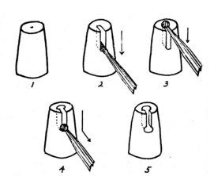
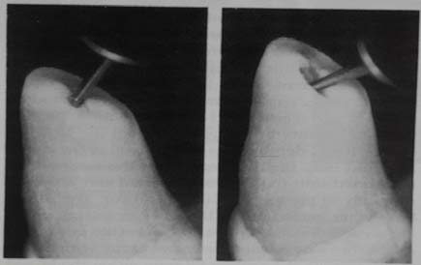
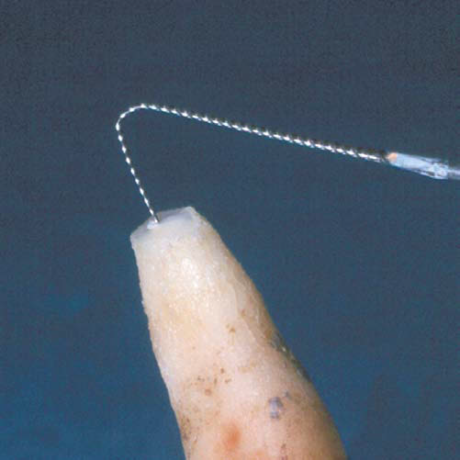
Vertical Slot Preparation
Preparation Perpendicular to the Cut Root Surface
“Matsura” apical root-end cavity preparation
Reverse Canal Instrumentation
Naik et al ; Techniques of root end preparation for the successful peri-radicular surgery: A literature review; International Journal of Applied Dental Sciences 2016; 2(2): 06-10

Slide 23
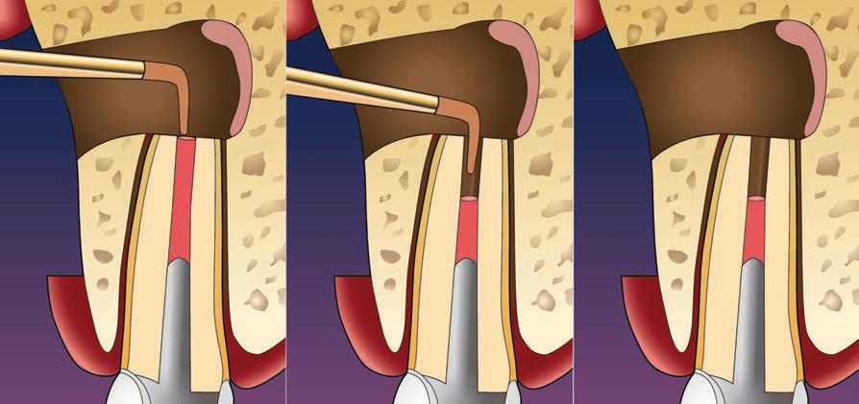
Long Axis Preparation
Root-end preparation begins with aligning a selected ultrasonic tip along the root prominence on the buccal plate under low magnification.
(4–8) to ensure that the preparation follows the long axis of the root. Once the ultrasonic tip is aligned, the preparation is carried out under midrange magnification (10–12).
Ultrasonic tips are used in a light, sweeping motion: short forward/backward and upward/downward strokes result in effective cutting action.
Interrupted strokes are more effective than a continuous pressure on the dentine surface.

Slide 24
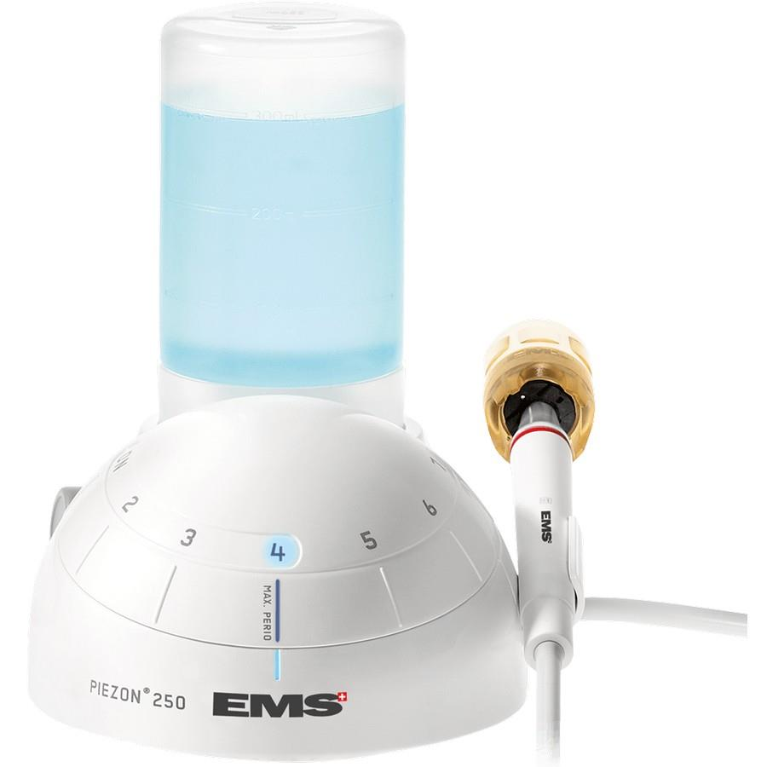
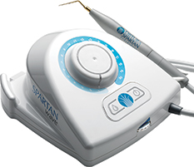
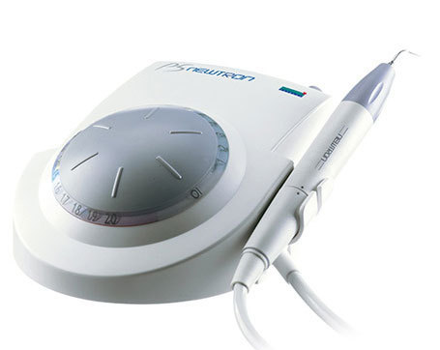
ULTRASONIC UNITS
Piezoelectric ultra sonic instrument for root end preparation.
Create vibrations in the range of 30 to 40 kHz by exciting quartz or ceramic piezoelectric crystals in the handpiece.
Continuous irrigation along the cutting tip cools the surface and maximizes debridement and cleaning.
Acteon P-5 has both Piezotome for Groove preparation and ultrasonic root end preparation
Notes:
The energy created is carried to the ultrasonic tip, producing forward and backward vibrations in a single plane.
The three most widely used ultrasonic units are the EMS, the Spartan (Spartan/Obtura), and the P-5 (Acteon).

Slide 25
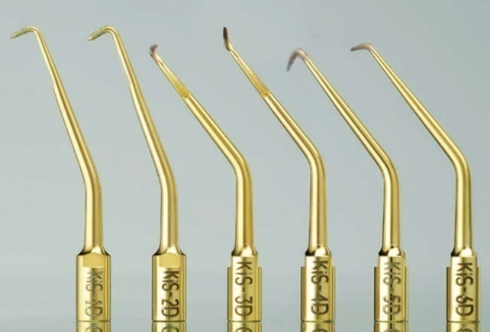
ULTRASONIC TIPS
The first ultrasonic tips for endodontic surgery were stainless steel Carr Tips (CT 1–5) in 1990.
Kim Surgical (KiS) tips
Introduced in 1999 by Spartan/Obtura
The KiS ultrasonic tips have a better cutting ability and a more efficient irrigation port.
They are coated with zirconium nitride and have an irrigation port near the tip rather than along the shaft.
These advanced tips cut faster and smoother and cause fewer microfractures because of the improved positioning of the irrigation port.
Notes:
Stainless
steel tips appear to produce less superficial debris and smear layer; Coating of ultrasonic tips
undoubtedly improves the cutting efficiency compared with
uncoated stainless steel tips; this translates into significantly
less time required to prepare a root-end cavity Coated root-end preparation instruments
typically produce a heavily abraded, debris-covered cavity
wall surface

Slide 26
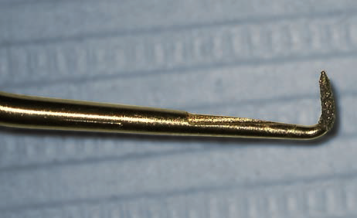
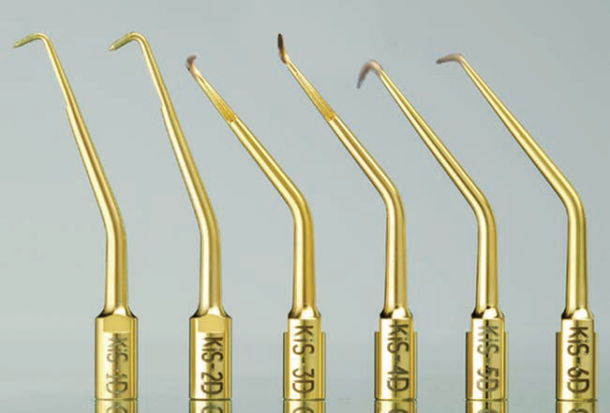
The KiS 1 tip - 80 degree angle
- 0.24 mm diameter & 3 mm long
- mandibular anterior teeth and premolars
The KiS 2 tip - wider diameter tip for wider teeth like maxillary anteriors
The KiS 3 tip - for posterior teeth; double bend and a 75 degree angled tip for use in the maxillary left side or the mandibular right side.
The KiS 4 tip is similar to the KiS 3 tip angle is 110 degrees, to reach the lingual apex of molar roots.
The KiS 5 tip is the counterpart of the KiS 3 tip
The KiS 6 tip is the counterpart of the KiS 4 tip

Slide 27
TAKE HOME MESSEGE/ FOR THE TOPIC COVERED (SUMMARY)
The principle treatment modalities for the management of post-treatment periapical pathosis are orthograde retreatment and apical surgery.
A significant advantage to surgical intervention is that it offers immediate access to the root apex.
Furthermore, it includes curettage of the periradicular granulomatous tissues and the resection of the apical 3 mm of the root, which frequently contains infected canal ramifications

Slide 28
Question & Answer Session
1. Write a short note on management of gutta percha in retro prepared cavity .
2. Write in brief about root end preparation.
3. Short note on root end conditioning.

Slide 29
REFERENCES NAME OF THE BOOK WITH EDITION AND PAGE NUMBERS ARTICLE ARE TO BE MENTIONED IF NEEDED
Ingle JI, Bakland LK. Endodontics. 4th ed. Philadelphia:Williams and Wilkins; 1995.
Grossman LI, Oliet S, Del Rio C. Endodontics. 11th ed. Philadelphia: Lea and Febiger; 1988
Rowe AHR. Damage to the inferior dental nerve during or following endodontic treatment. Br Dent J 1983;153:306
Seltzer S, Bender IB, Turkenkopf S. Factors affecting successful repair after root canal therapy. J Am Dent Assoc 1963;67:651
Walia H, et al. Use of a hemostatic agent in the repair of procedural errors. JOE 1988;14:465.

